Slide 1
Customer Complaint Tracking System
Instructor:
Engr. Syed Muhammad Umer
Group Members: 2025-MC-155
2025-MC-159

Slide 2
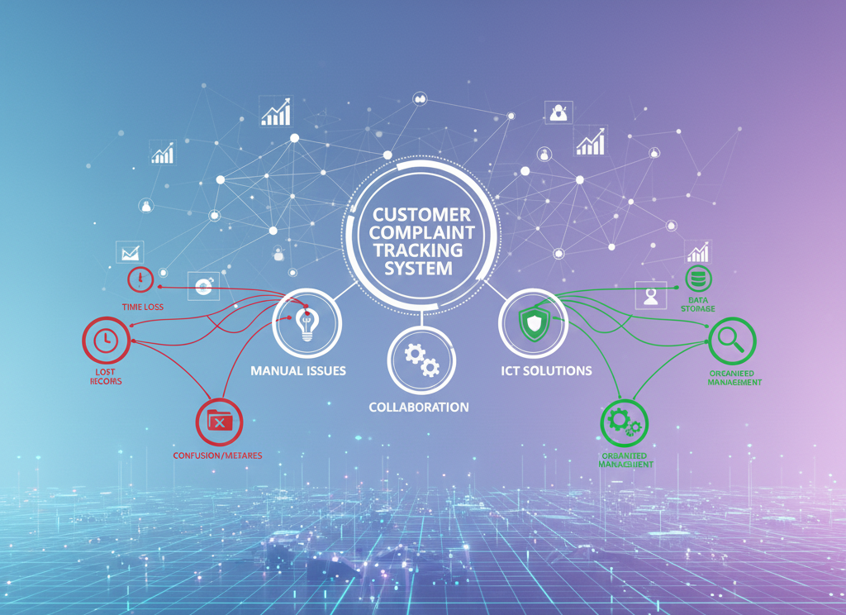
Introduction
Customer complaints are common in service organizations
Handling complaints manually takes more time
Manual systems create confusion and mistakes
ICT helps manage complaints in a better and organized way
Complaint data can be stored safely using ICT
Complaint status can be checked easily
This project designs a Customer Complaint Tracking System using ICT tools

Slide 3

Problem Definition
Many organizations use paper or simple files for complaints
This causes delays in handling complaints
Complaint records can be lost
Complaint status is difficult to track
A proper computerized system is needed

Slide 4
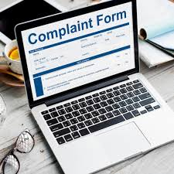
Objectives of the Project
Design a simple complaint tracking system
Store complaint data in an organized database
Make complaint status easy to check
Use ICT tools for system development and documentation

Slide 5

Proposed System
Customers submit their complaints
Complaints are stored in a database
Complaints are assigned to support staff
Each complaint has a status:
Open
In-Progress
Closed
The system reduces delays and confusion

Slide 6
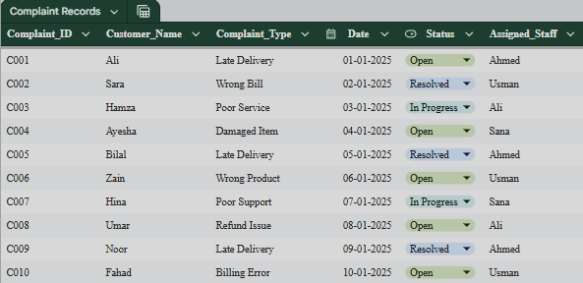
Dataset Creation and Analysis
A dataset of 10 complaint records is created
Google Sheets is used to create the dataset
Dataset includes:
Complaint ID
Customer name
Complaint type
Date
Status
Assigned staff

Slide 7
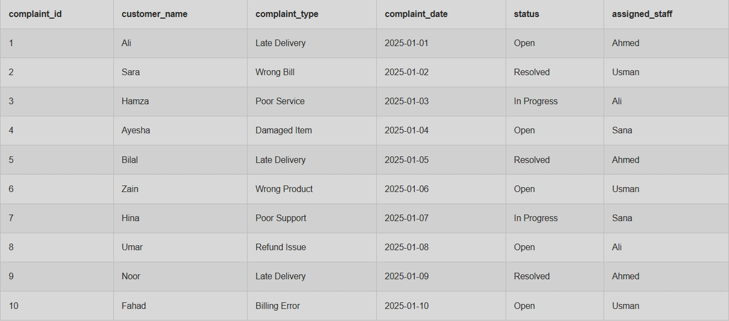
Database Design (DBMS Schema)
Customer Table stores customer information
Complaint Table stores complaint details
Support Staff Table stores staff information
Primary keys and foreign keys are used
Relationships between tables are maintained

Slide 8
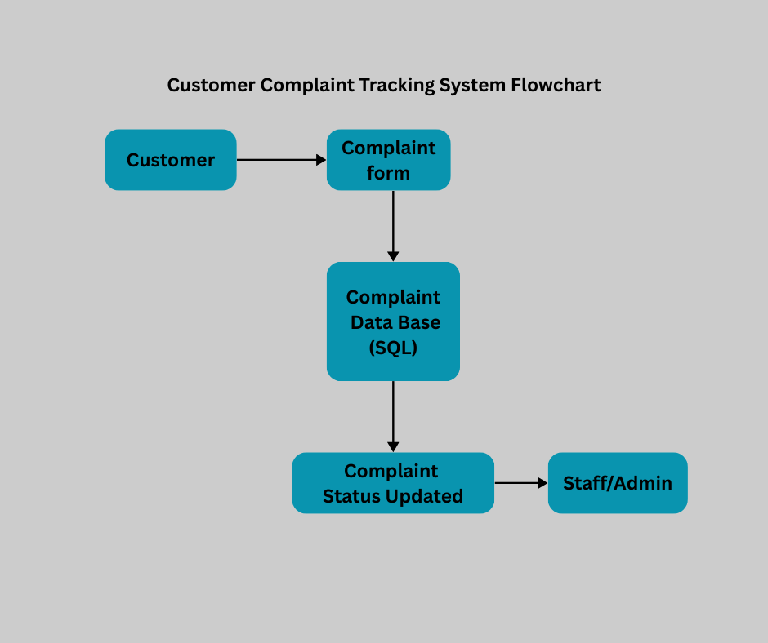
System Diagram
System diagram is created using Canva
Diagram shows complaint flow
Flow includes:
Customer submission
Database storage
Assignment to support staff

Slide 9






ICT Tools Used
Google Sheets for dataset creation
DBMS concepts for database design
Canva for system diagram
Overleaf for report writing
GitHub for project submission
Mendeley for references

Slide 10

Results
Complaints are managed in an organized way
Response time is faster
Complaint status is easy to track
Manual work is reduced

Slide 11

Conclusion
The system is an effective ICT-based solution
It improves customer complaint management
Project meets Complex Engineering Activity (CEA) requirements
Shows practical use of ICT tools in real-world problems

Slide 12
Thank you!

